Slide 1
Toolbar

Slide 2
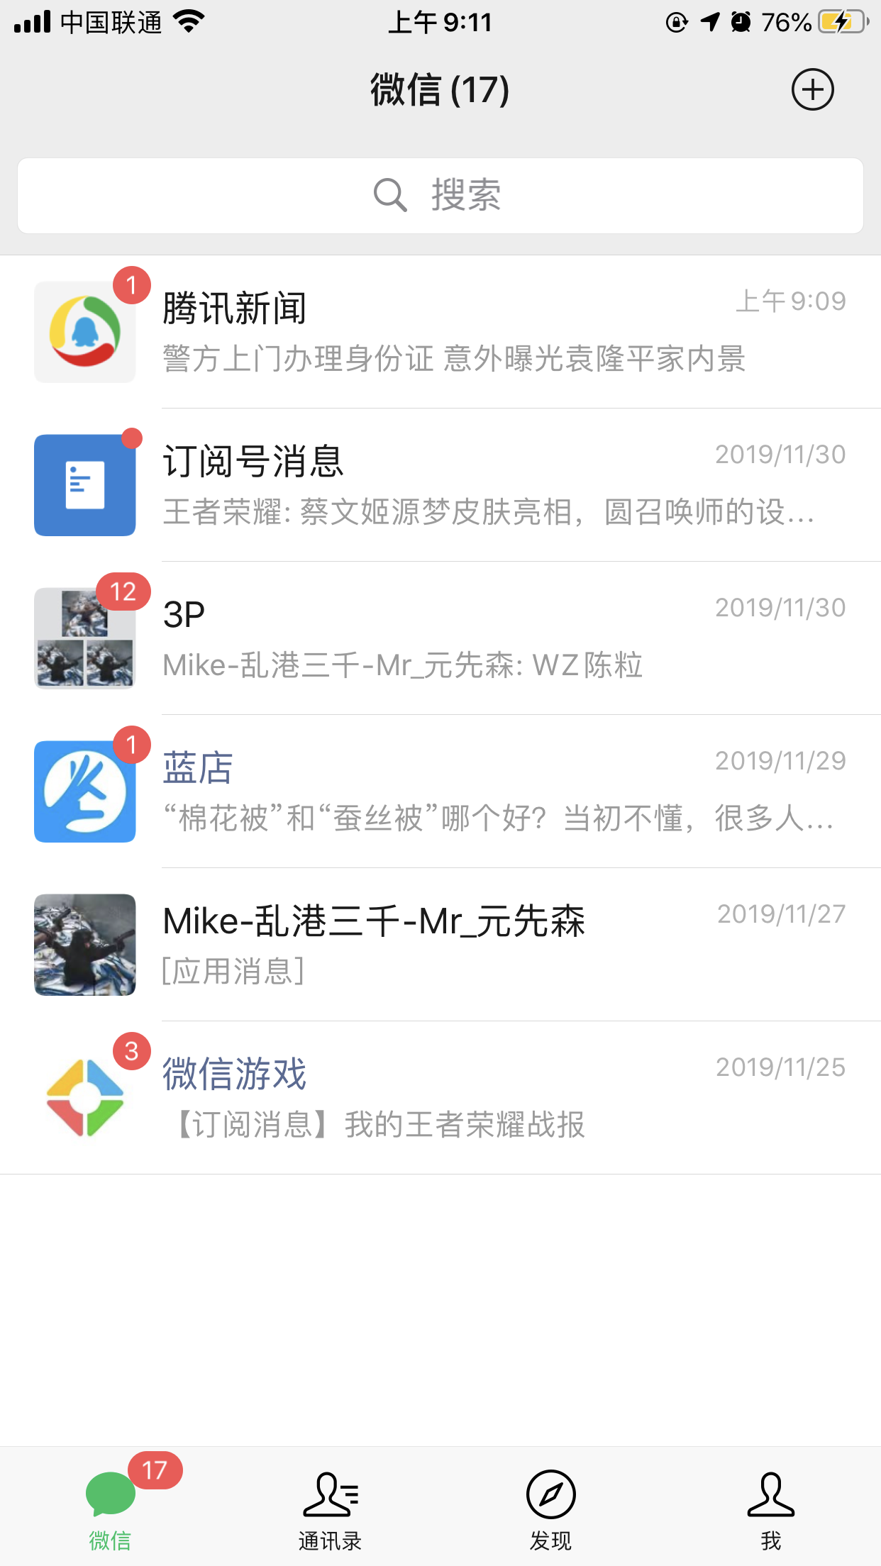

Slide 4
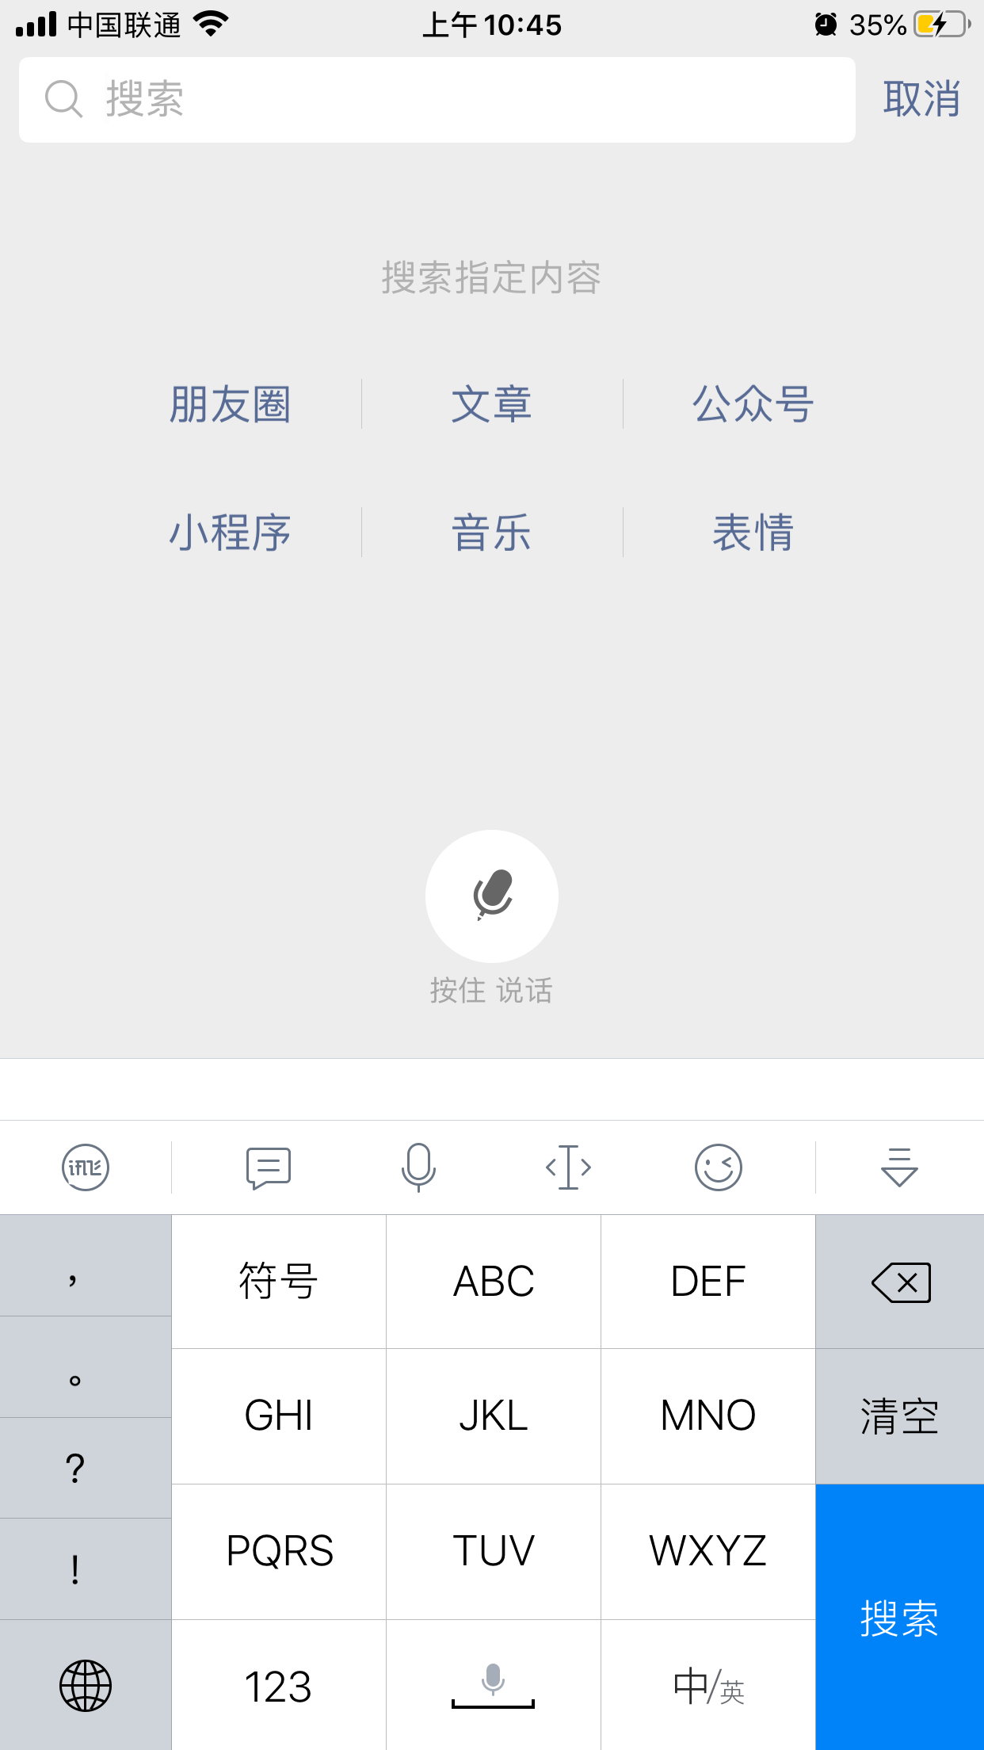

Slide 6
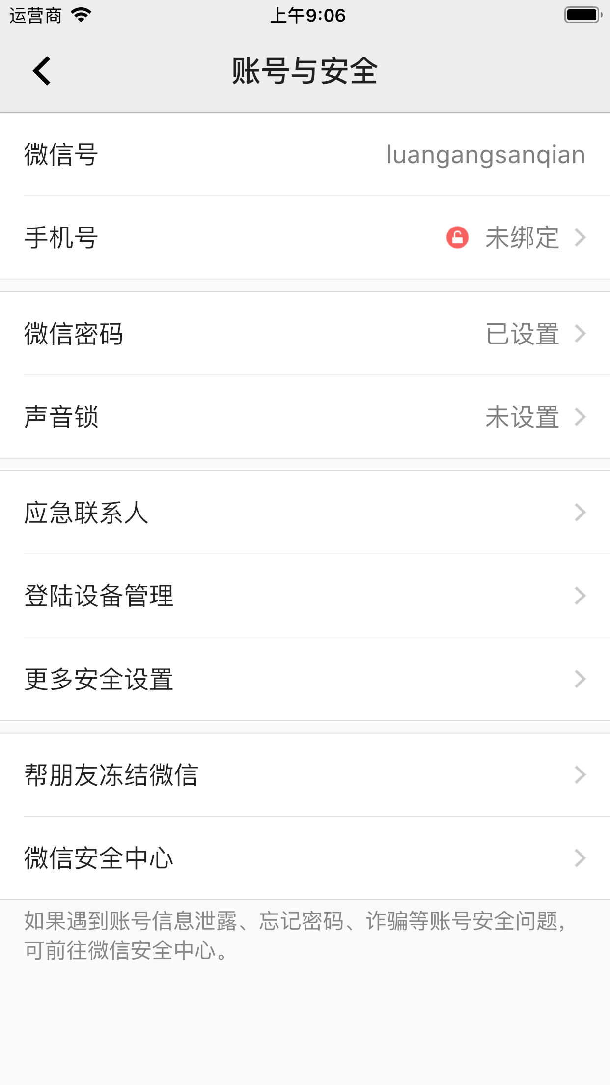

Slide 8
标题
Logo
Action
Menu
导航

Slide 10
历史

Slide 11
Appbar

Slide 12
App bar
Action bar

Slide 13
App bar
Action bar
Tool bar

Slide 15
Action bar

Slide 16
[演示]

Slide 17
Tool bar

Slide 18
[演示]

